Slide 1
Navigating the Best Route for Providing Assistive Devices
Jennifer Ottowitz, CVRT
OIB-TAC webinar

Slide 2
Objectives
Explain the best practice for promoting client choice in assistive devices.
Describe 3 strategies for managing client expectations about assistive devices.
Identify strategies for building client confidence in managing maintenance and replacement of assistive devices.

Slide 3
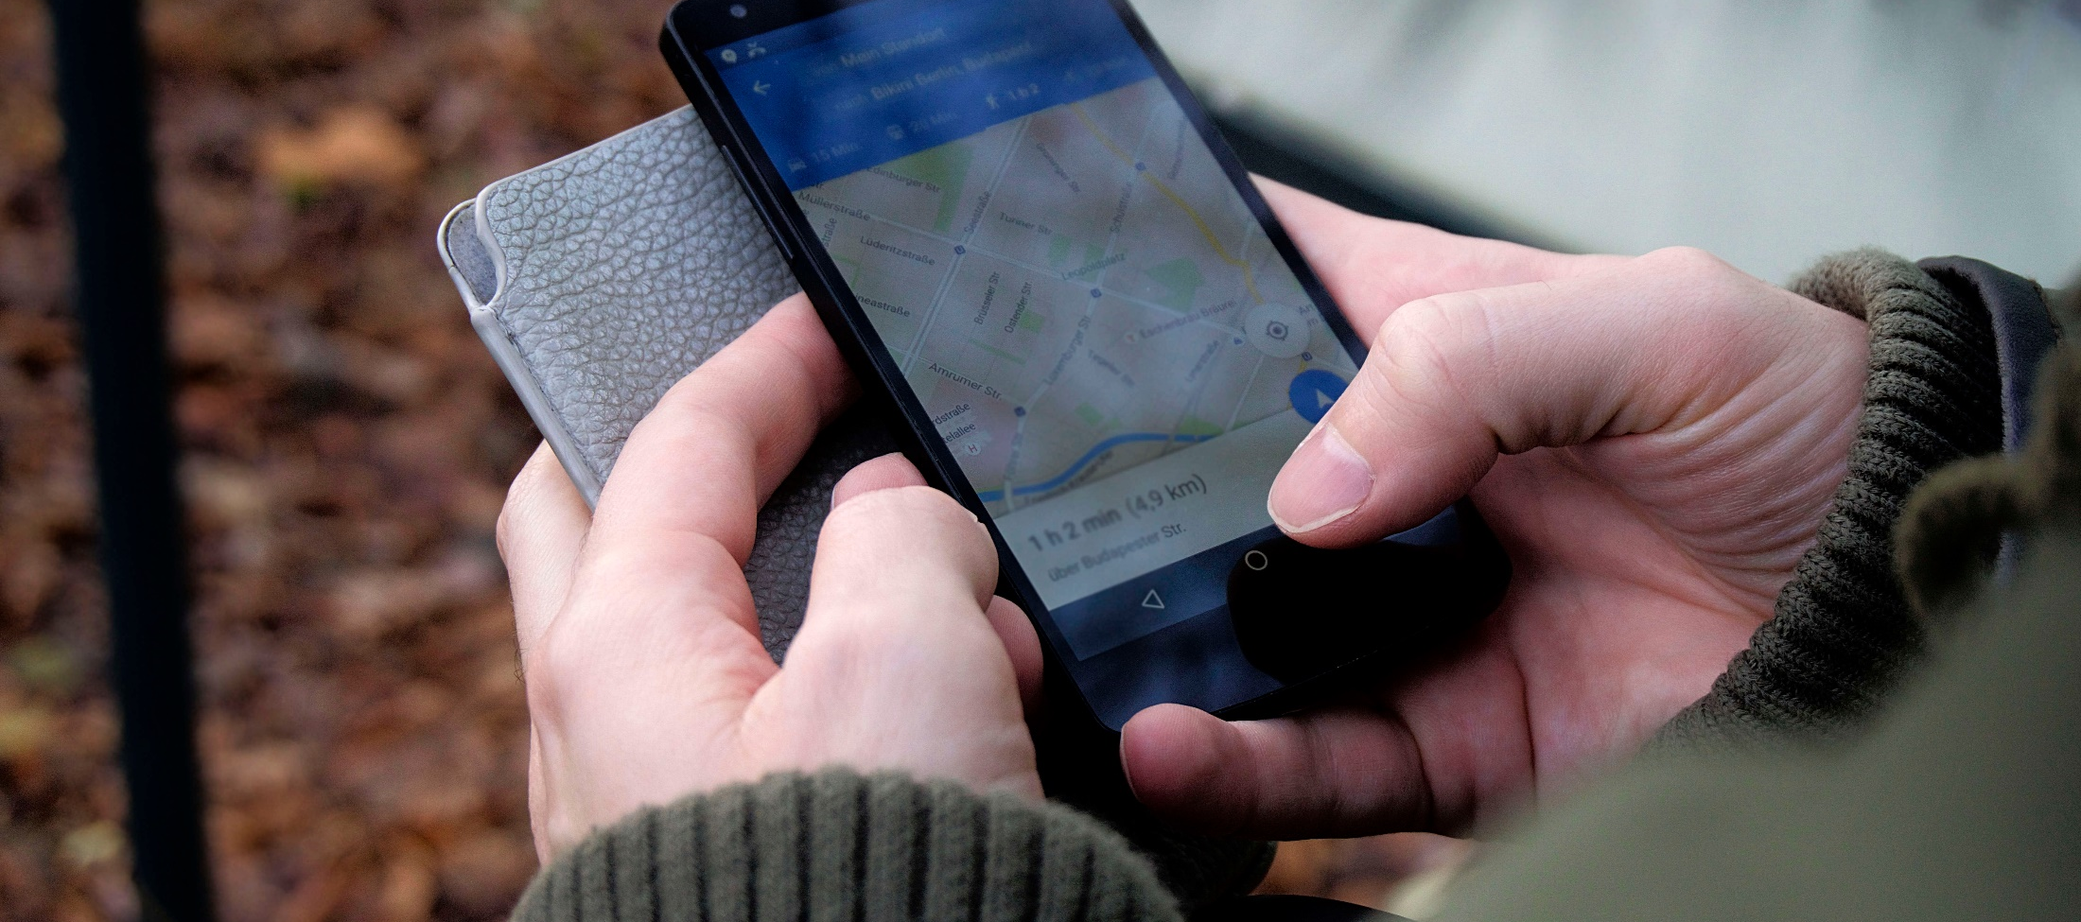
Start With the Destination in Mind

Slide 4
What are assistive devices?

Slide 5
Federal Definition
As defined in Section 3(4) of the Assistive Technology Act of 2004 (Pub. L. 108-364) https://www.govinfo.gov/content/pkg/STATUTE-118/pdf/STATUTE-118-Pg1707.pdf
Assistive Technology Device:
Any item, piece of equipment, or product system whether acquired commercially, modified, or customized, that is used to increase, maintain, or improve functional capabilities of individuals with disabilities.
May include canes, slates, insulin gauges, CCTVs, computers, adaptive software, magnifiers, adaptive cooking items, adaptive recreational items, handwriting guides, braille devices, and large button telephones, etc.

Slide 6
AT Services Defined
Assistive technology services may include:
the evaluation of assistive technology needs of an individual
services related to acquisition of technology
loan programs
maintenance and repair of assistive technology
training or technical assistance for the individual or professionals related to the use of assistive technology
programs to expand the availability of assistive technology
low vision services related to the use of optical aids and devices, and other services related to the selection, acquisition, or use of an assistive technology device.

Slide 7

Getting What You Need for the Trip

Slide 8
Funding for AT
Older Individuals who are Blind federal grant with documentation of number of clients receiving service provided on annual 7-OB report
Vocational rehabilitation services if necessary and appropriate to perform the essential functions of the job
Veterans Affairs for veterans or active-duty service members
iCanConnect
Service organizations (e.g., Lions Clubs)
Low interest loan programs/Tech Act Centers

Slide 9
Resources to Obtain AT Devices
Computers for the Blind
National Federation of the Blind (free white cane and free slate and stylus programs)
Retail stores and companies specializing in assistive devices

Slide 10
Additional Resources
Amazon and other online vendors
Department, craft, hobby, and hardware stores
Restaurant supply stores

Slide 11
What creative resources have you used or recommended to clients for obtaining assistive devices?

Slide 12

Gearing Up

Slide 13
OIB-TAC Best Practices for Managing AT
Agencies will have guidelines regarding inventory control, supplies, and equipment management.
Devices that promote consumer health and safety are a priority.
Identifying and accessing other funding sources and encouraging consumer responsibility for purchases, regardless of cost, is a positive practice.
State-approved vendors for bulk purchases can be an effective practice.
Some OIB programs have been successful in getting additional funding from other sources for programmatic expenses, including assistive technology. When potential opportunities arise to expand funding, staff will pursue efforts to secure it.
Devices for nonessential tasks and some non-specialized devices, such as crock pots, will be the consumer’s responsibility; although, techniques to facilitate use and safety (e.g., raised dots) may be provided.
It is inappropriate for states to assume long-term financial responsibilities or provide services such as internet access (OIB-TAC, 2018).

Slide 14
Identifying Ownership and Responsibilities
Who owns the device?
Who is responsible for care and maintenance?
Who is responsible for replacement if a device stops working, is damaged, or is stolen?
Establish and communicate this at the start.

Slide 15
Communicate Limits on Funding
If agencies allocate funding per client for devices, inform client of spending caps.
Let clients know how funding could be used (for one item or for several).
Letting them know funding limits means no surprises.

Slide 16

Which way do we go?

Slide 17
Identify Need Through Assessment
Document what was needed based on assessment.
Provide instruction on the use of recommended devices.
Tie training to identified goals.
Document what training occurred and client outcomes.
Document how device met assessed need. Post assessment: Client uses magnifier to read food package labels and access information on her bills.

Slide 18
Determining What’s Most Helpful
Research has shown that low vision devices are abandoned about 19% of the time (Dougherty & Kehler, 2011).
Demo kits
Loan programs and trial periods
Hands-on in retail stores

Slide 19
Best Practice — Demo Kits
To conserve expenses and facilitate training time, staff may use demonstration kits to show consumers the details or functioning of devices and to give a basic demonstration of how to use the device.
Best done when the person expresses interest in the device, rather than after it is received (OIB-TAC, 2018).

Slide 20
Determining What’s Most Helpful Continued
Discuss pros and cons of each assistive device with clients.
Devices should address client needs and goals rather than your own personal preferences.
Consider client’s current skills and additional disabilities.

Slide 21
All Possible Options
Inform clients of what is available and how to obtain it regardless of your program’s ability to provide it.
Otherwise, clients may not know what to ask for or where to find it.
Give them a starting point.
Help identify possible resources (family, sources of used devices, resources noted earlier).

Slide 22

Roadside Assistance

Slide 23
Care and Maintenance of Devices
Introduce care, maintenance, and troubleshooting as part of training.
Introduce resources for customer and technical support.
Be aware of return policies and warranties.
Changing batteries can be an opportunity to explore further training.
Balance helping as a favor with reinforcing dependence.

Slide 24

Getting Back On Course

Slide 25
Moving Closer to Best Practice
The ABC OIB program does not purchase or train on the use of computers. They state they do not have staffing to provide software/training. Clients do have access to “borrow” iPads or iPhones.
What could this state’s program do to get closer to best practice for managing assistive devices?

Slide 26
Moving Closer to Best Practice
A client receives a device then comes back a few years later requesting a new purchase because the device was lost when they moved.
What is your limit for purchasing a device for the second time?
What if the device was broken instead of lost?
How can the agency move closer to best practice?

Slide 27
Moving Closer to Best Practice
How does your agency handle the following?
Paying for an upgrade to a provided device
If a client purchases a device and requests reimbursement
If a client insists a device be purchased because others in their low vision peer support group have been raving about how helpful it is

Slide 28

Support Along the Way

Slide 29
Networking
Connect with others locally and within your organization.
Build relationships with vendors.
Reach out to other professionals within the field.
Helpful for identifying appropriate devices, ideas for acquiring/funding devices, and tips for assessment/teaching/documentation.

Slide 30
References & Resources
OIB-TAC Best Practices 2018
Veterans Affairs U.S. Blind Rehabilitation
Loan programs/Tech Act Centers

Slide 31
References & Resources Continued
iCanConnect
Computers for the Blind
Dougherty, B. E., & Kehler B. K. (2011). Abandonment of low-vision aids in an outpatient population. Optometry and Vision Science, 88(11) 1283-1289. https://doi.org/10.1097/opx.0b013e31822a61e7

Slide 32

Destination reached. Ready for the next trip?

Slide 33

The Older Individuals who are Blind Technical Assistance Center (OIB-TAC) is a development of the National Research & Training Center on Blindness and Low Vision (NRTC) at Mississippi State University, focused on agencies serving older individuals who are blind. This grant (H177Z200001) is funded by the Rehabilitation Services Administration (RSA) under the U.S. Department of Education.

Slide 34
Name: Jennifer Ottowitz, CVRT
Email: jottowitz@colled.msstate.edu
Phone: (662) 325-2001
For more information, please contact:
OIB-TAC: www.oib-tac.org
NRTC: blind.msstate.edu
ntac.blind.msstate.edu
www.facebook.com/theNRTC www.twitter.com/MSU_NRTC
P.O. Box 6189
205 Morgan Avenue
Mississippi State, MS 39762
P. 662.325.2001

