Slide 1
Diné (Navajo) Elders, Blindness and Cultural Competence
Part One
By Sacheen Smith
New Mexico Commission for the Blind

Slide 2
Purpose
Learn Diné Way of Life
Learn how Diné elders experience health, disability and blindness
Integrate Diné cultural foundations into services
Understand the Borderland Framework
Strengthen cultural competence for providers
Promote respectful, relational approaches—not transactional ones

Slide 3
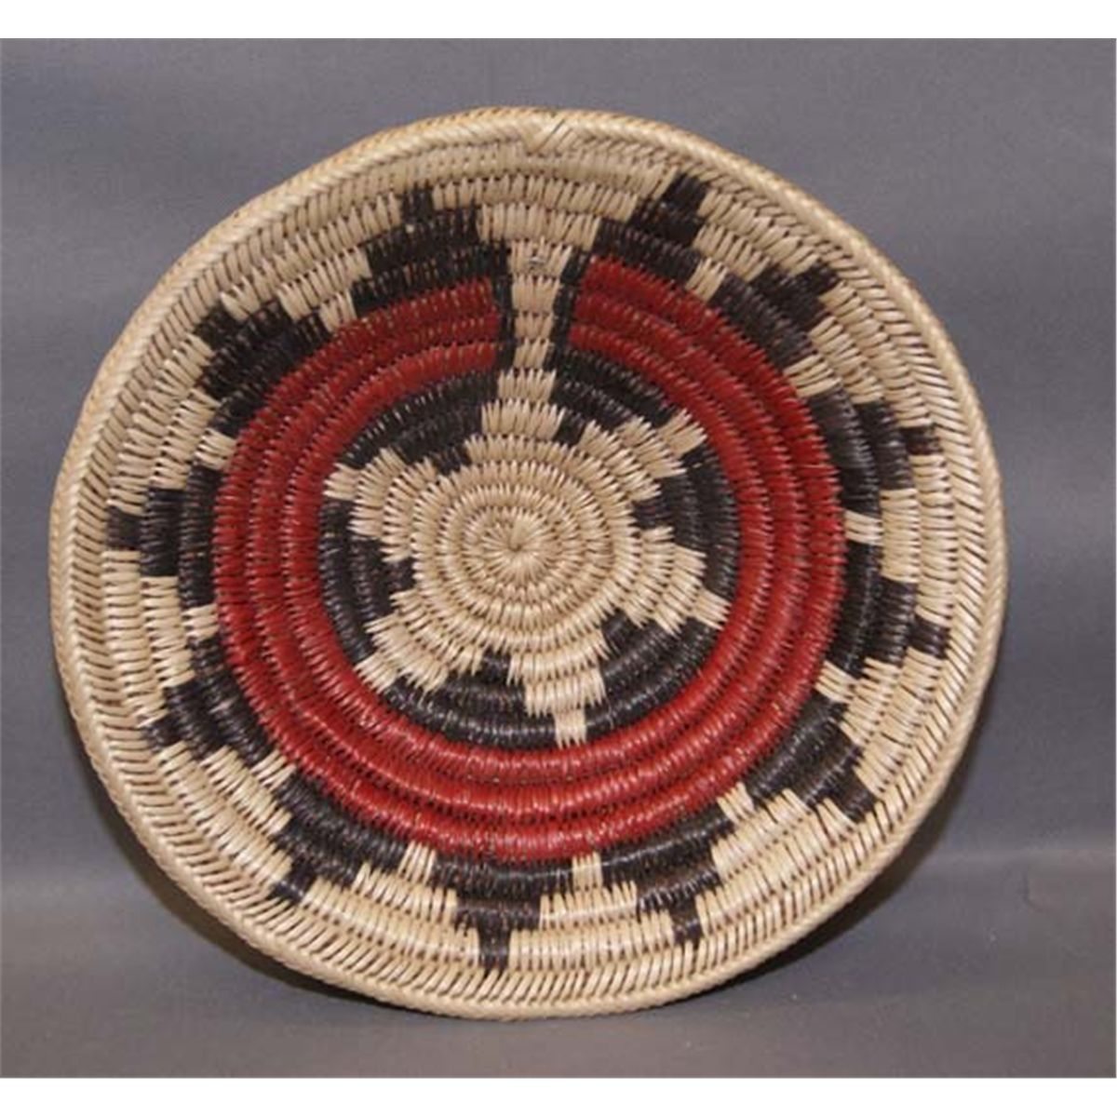
Understanding Diné (Navajo) Way of Life
K’e’: kinships, relationships and community bonds are central
Shape individual identity and cultural continuity
Influence social structure
Guides behavior
Duty to one another, civic responsibility

Slide 4
Hózh̨ǫ́—Balance and Harmony
A holistic sense of living in beauty, harmony, and positive relationship with self, family, land, and spirit
Includes emotional, physical and relational wellness —not just the absence of illness
Expressed through behavior, speech, choices and maintaining respectful relationships
Colonization, boarding schools, and displacement disrupted hózh̨ǫ́, making restoration vital for healing today

Slide 5

Hózh̨ǫ́—Balance and Harmony Examples
Example 1: A child with a disability is still “in hózh̨ǫ́” when they are loved, included, and connected to family—even with medical needs
Example 2: A person “walks in beauty” while managing chronic illness; healing includes emotional relational balance
Example 3: In disability services, a rigid schedule may conflict with a family’s need to attend a ceremony. A hózh̨ǫ́-centered approach allows flexibility to maintain harmony

Slide 6
Balance in Diné Life— Complementary Pairs
Diné way of Life teaches that balance comes from pairs
Neither side is “better.” Both are required to live in hózh̨ǫ́ (harmony)
Balance Pair
Day/Night | Work vs. Rest: Learning cycles, seasonal stories
Male/Female Energies | Complementary Roles: Weaving, clan lineage, hogan teachings
Physical/Spiritual | Land connection, Weaving, herding
Individual/Community | Clan identity, shared labor, elder care

Slide 7
Day/Night
Day and Night are partners, each with responsibilities
Both complete the life cycle
Examples
Morning | Prayers, new energy, learning
Night | Rest, reflection, winter storytelling
Day | Physical work (herding, weaving, farming)
Night | Thinking, family time, carding wool

Slide 8
Male/Female Energies
Male and Female energies are complementary—not rigid roles
Both energies exist in the world and within each person
Examples:
Hogan teachings: male (ceremonial), female (home, birth)
Weaving: men prepare the loom, women weave
Kinship: clans inherited through the mother; male relatives teach/protect
Within each person: strength + gentleness, action + nurturing

Slide 9
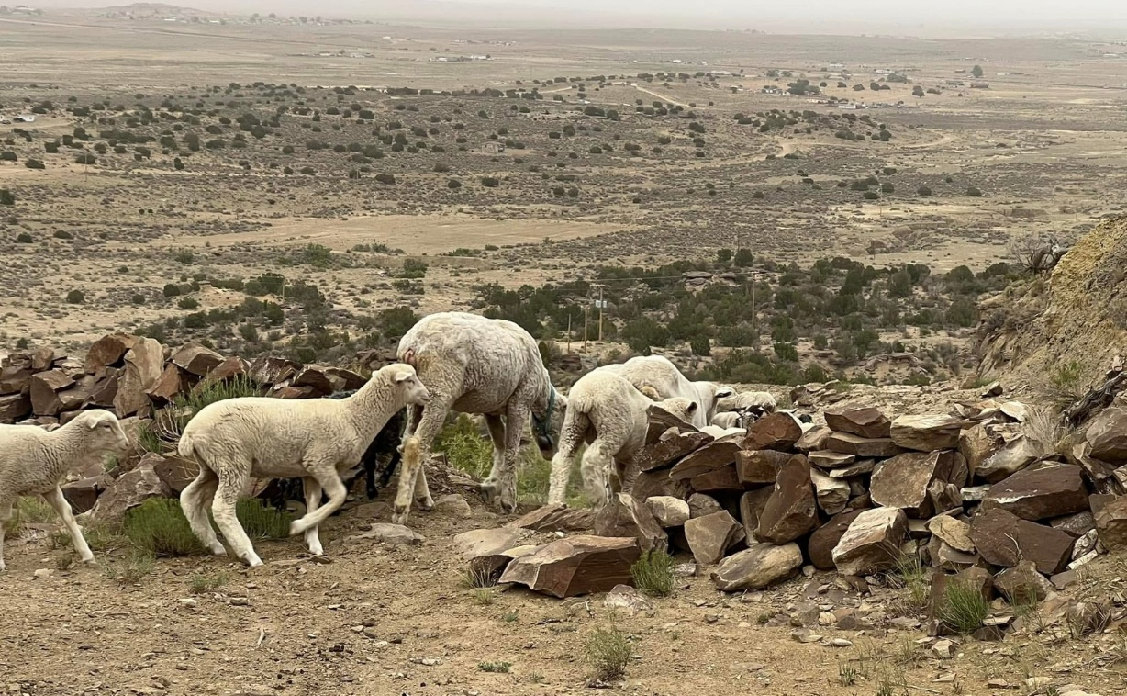
Physical/Spiritual
Physical Health and spiritual wellbeing are inseparable in Diné way of life
Herding Sheep = movement + spiritual connection to land
Weaving = physical craft + spiritual meaning of the loom
Community Service = physical labor + relational responsibility

Slide 10
Individual/Community
Identity comes from clan relationships and responsibilities to others
Examples:
Elder care: one person chops wood, family provides full support
Herding: an individual works, but the herd belongs to the family
Children learn responsibility through helping (animals, grand[parents, home)

Slide 11
Diné Clans — Identity, Relationship & Cultural Competence
Clans = Identity & Relationship
Diné introduce themselves through four clans to show who they are and how they relate to others
Clans guide resoect, roles, responsibilities, and boundaries
The Four-Clan System
Mother’s clan (born for)-primary identity: Tsé Ńjíkiní — Cliff Dweller/Among the Rocks/Rebuilding a Rock House/Honey Combed
Father’s clan: Áshįįhí — Salt Clan
Maternal Grandfather’s Clan: Hashtł’ishnii — Mud/Clay
Paternal Grandfather’s Clan: Hooghan Łání — Many Hogans/Many Homes

Slide 12
Purpose of Clans
Establish kinship and prevent taboo relationships
Create instant family connections across Diné communities
Guide how to address elders (e.g., shimásání, shicheii)
Cultural Competence Insight
Honor clan introductions when offered
Understand elders may categorize helpers as relatives
Recognize clan ties shape trust, communication and consent

Slide 13
Clans: In Blindness Services
Clan introductions help elders feel safe and connected
Builds rapport for assessments, O&M instruction, and caregiving
Prevents unintentional cultural violations
Example:
When a Diné person shares their clans, it establishes:
Individual Identity
Community belonging

Slide 14
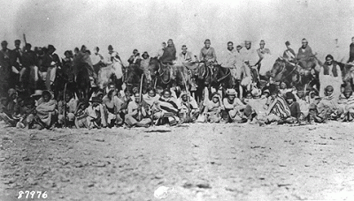
Historical Trauma & Diné Elders
The Long Walk (1863-1868)
The Boarding School Era (1819-1969)
Forced Sterilization (1970-1976)
Environmental Racism
Medical Neglect
Loss of Autonomy
Distrust as Survival

Slide 15
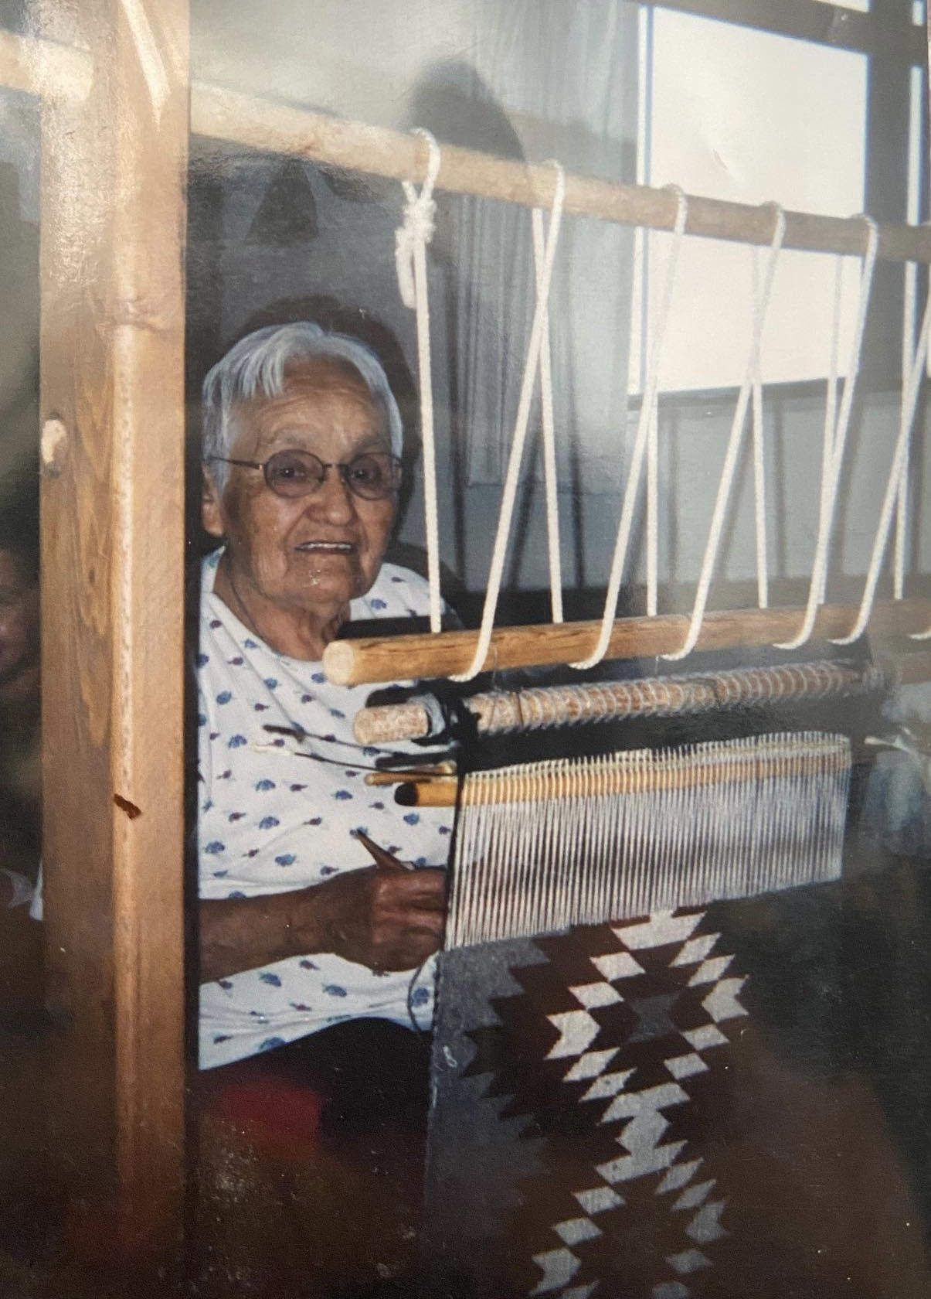
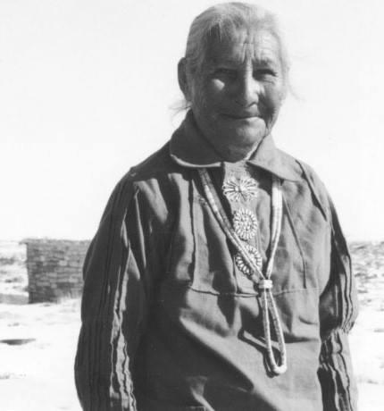
Questions

